Slide 1
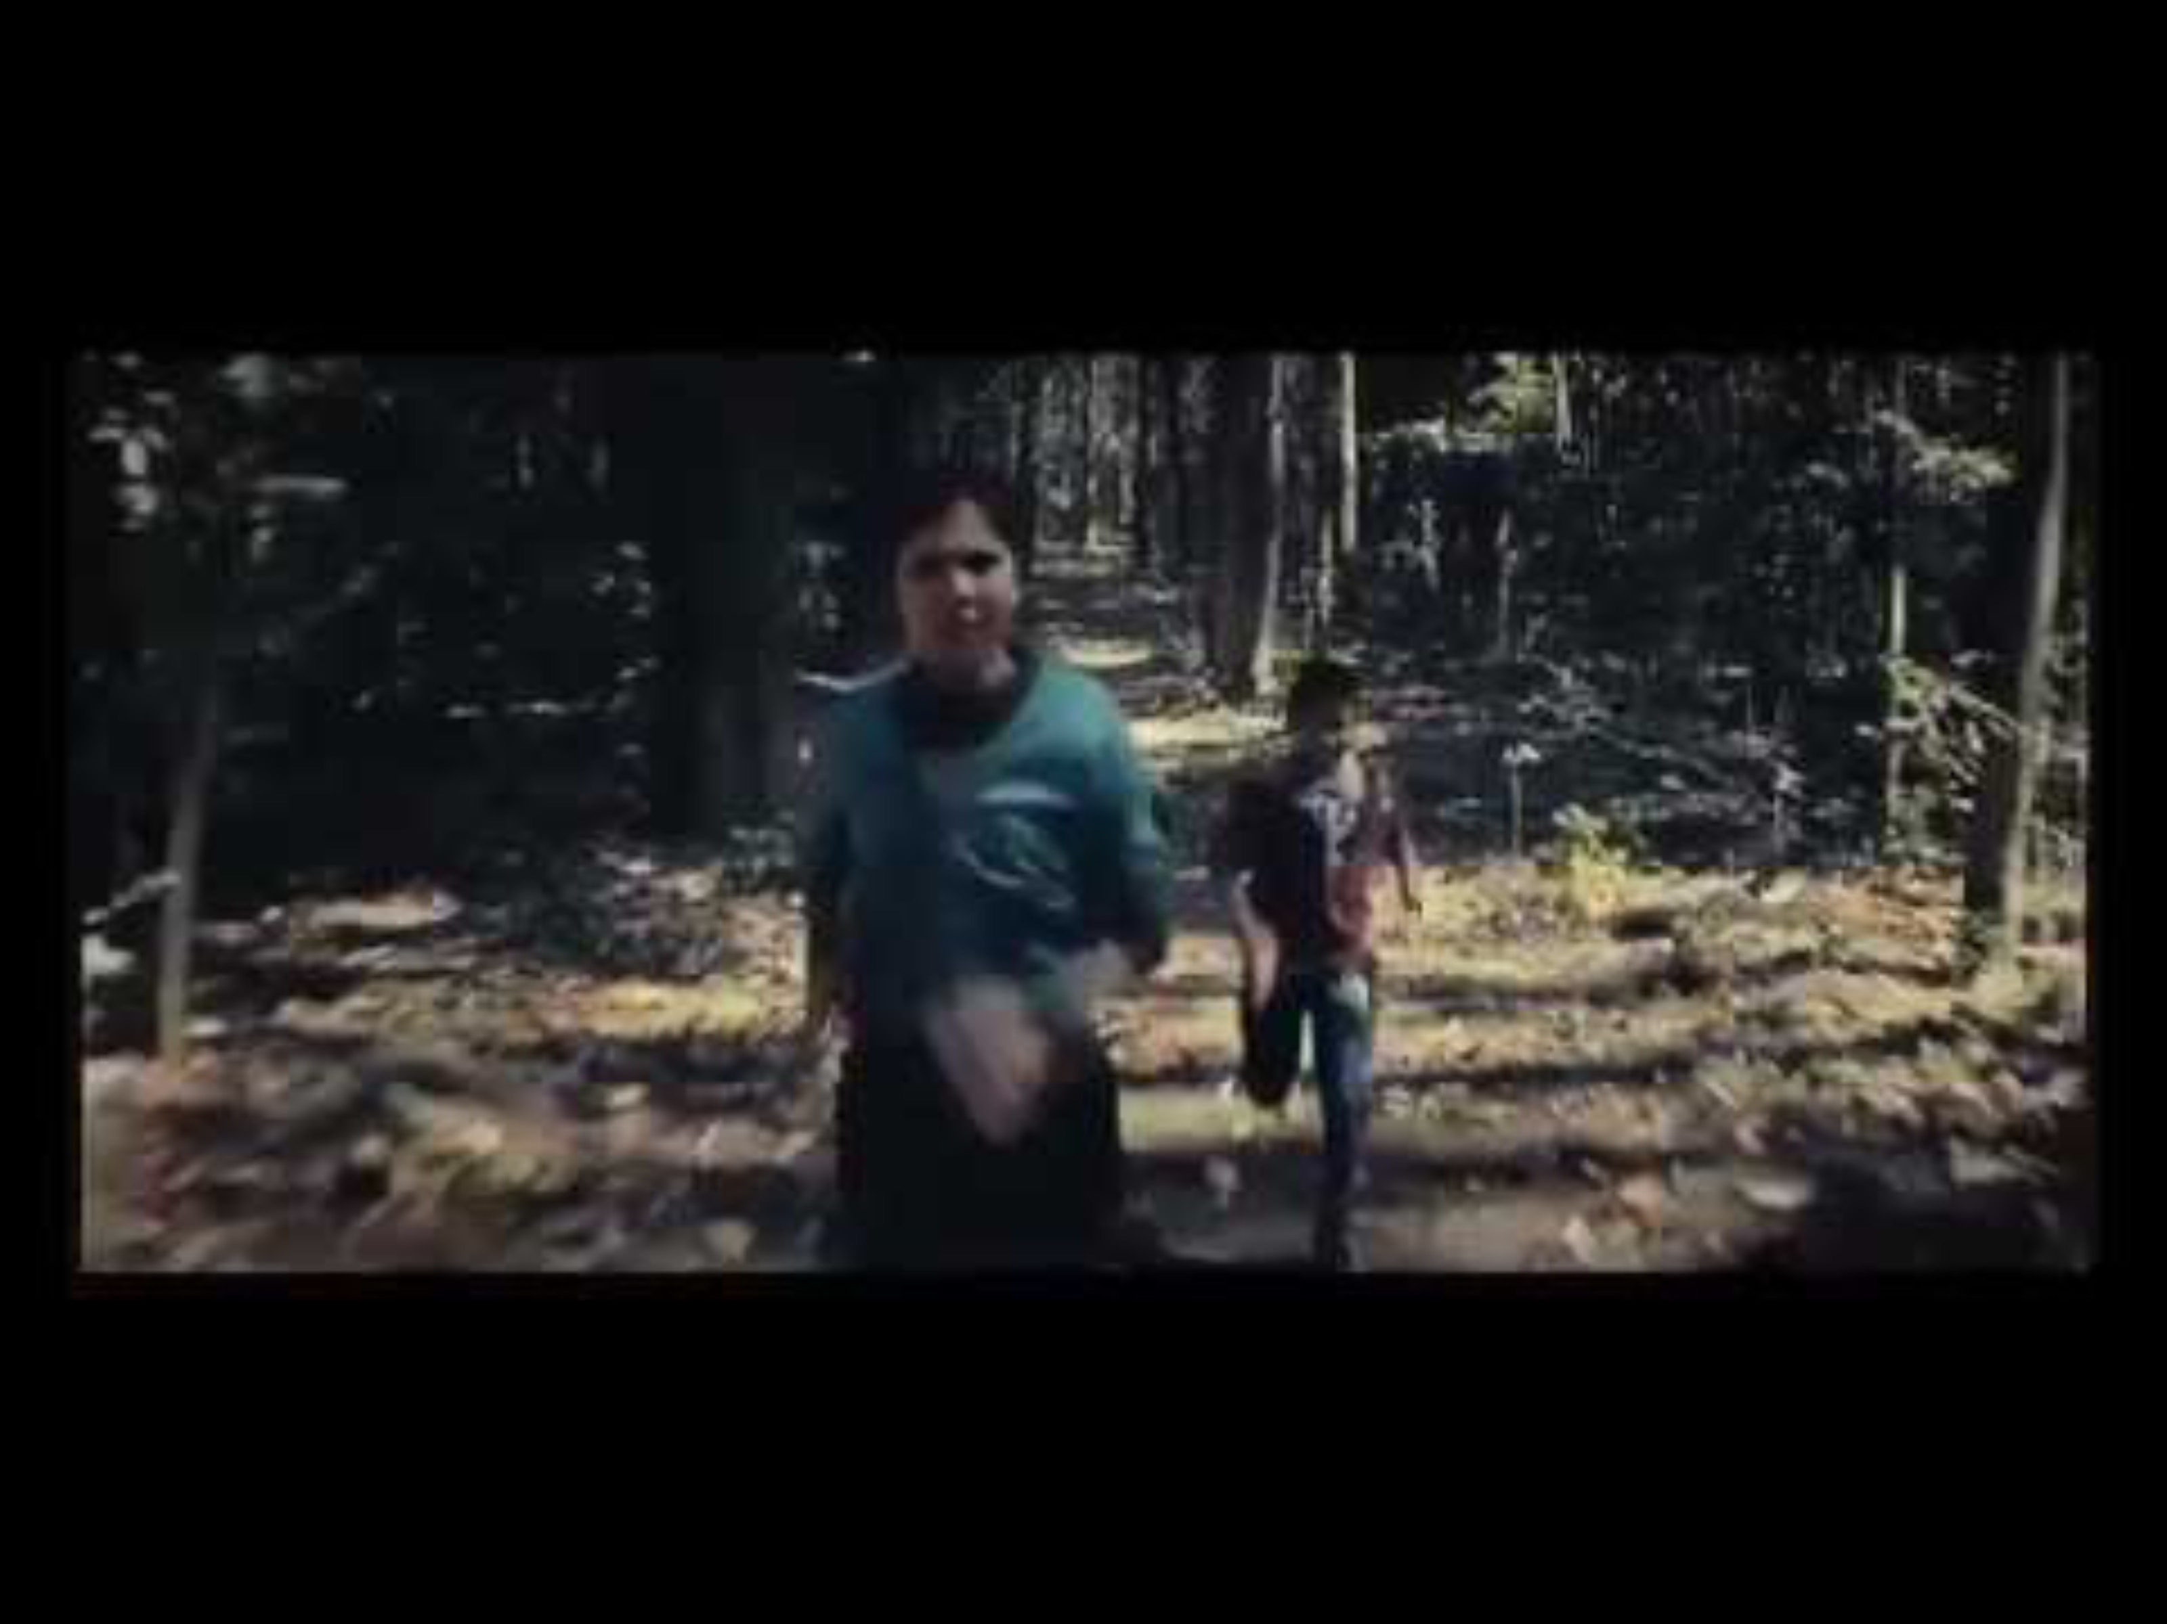
Lets have a look at this ad!
Notes:
https://www.linkedin.com/pulse/brand-stories-how-consumer-insight-helped-pampers-beat-sombit-roy

Slide 2
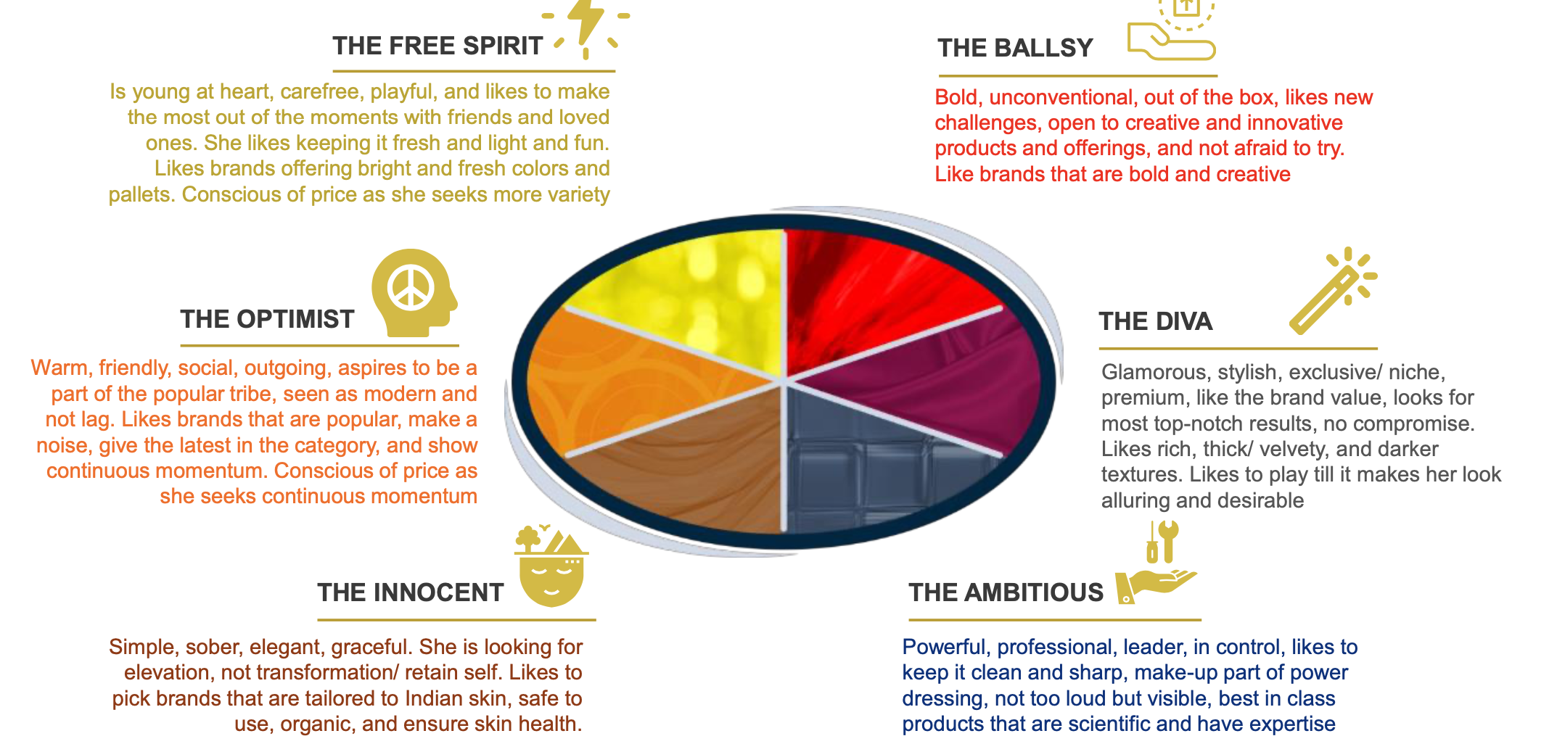
Trivia – Where does the Bournvita mother sit?

Slide 3
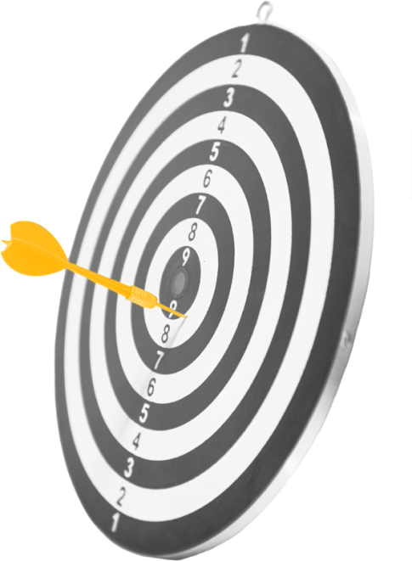
Once you have segmented…..now it is about making a Choice….
Choosing the Target Market…..Targeting!
Notes:
TRIB fashion Store

Slide 4

Targeting
WHAT IS TARGETING
WHAT IS TARGET MARKET
Selecting one or more segments
at which the marketing programs
of the company will be directed,
so as to meet the needs of those specific segments
The segment(s) that a firm selects to turn into consumers
Notes:
TRIB fashion Store

Slide 5
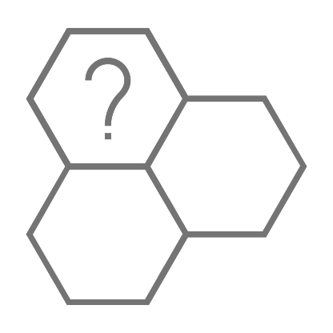


Selecting Segment
EXTERNAL FACTORS
INTERNAL FACTORS
Segment growth/Potential
Competition
Entry/Exit barriers
Substitutes
Bargaining Power of Buyers or Suppliers
Vision/Mission/Purpose
Competencies
Resources
Internal Competency

Slide 6
Pen Portrait of Your Consumer
Bringing your consumer to life – A detailed pic of your ideal consumer
Demographics
Needs, Wants
Motivation, Attitudes, Behavior
Interest, Hobbies
Core Values
Symbols, Icons
Why is this important?
Insights
Gaps/Opportunities/Pain Points
Core to Marketing Mix
Stakeholder Alignment
How to create one?
Research
Detailed Note
Pen Portrait
Core Values
Notes:
TRIB fashion Store

Slide 7
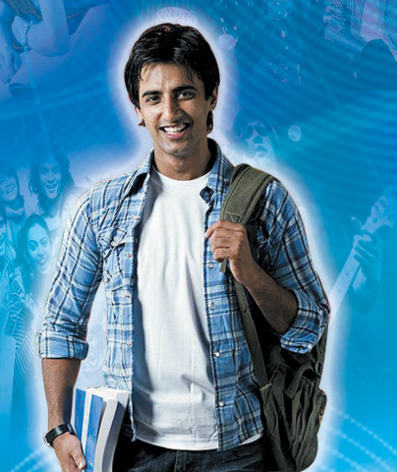
Pen Portrait of Aditya
Demographic
Age – 21
Profession – Student, Last year college. Part time freelance over the weekend
City – Bangalore
NCCSA
Aspirations
Alternate Profession
Car
Road Trips
Friend for Life
Attitude about Category ( Deo)
Funny ads, but why is all about sex
Deos is not about confidence, have all of it
Just need it to last and odour is not an impediment
Needs, Wants, Interest & Hobbies
Alternative profession – Photographer
Friends & Family
Fashion Style, very personal
Gaming & Sports
Loves Travel & Adventure
Core Values
Individualistic
Perpetual Seeker
Rooted
Social Recognition
Sense of Purpose
Day in the life
Hang outs
Gym
Entertainment
Gaming
Photography
Social Media

Slide 8
Core Values - A core value is a deeply held belief about what matters most in life. It guides how a person thinks, behaves, and makes choices—even in small things like what brand to buy.
Have it all….want it all
Fear of missing out
Always assessing on what is missing
Desire to Upgrade
Trend setter
Peer affirmations
Multiple gangs
Mentorship that is always on with friends
Individualistic
Perpetual Seeker
Rooted to Family
Social Recognition
Sense of Purpose
Delayed adult milestones
“so much more to do in my life”
Staying away from home
Disinterested in long standing institutions – E.g – Religion
Career oriented
Writing his own rules
Always plugged in with family
Seeks support and advice from parents
Demands ethics from his relationships be it friends or work
Wants to help out ….contribute back to the society

Slide 9

Exercise - 7
Make a Pen Portrait of Mother for a new MOMS Appliance Company – Core product Breast pumps

Slide 10
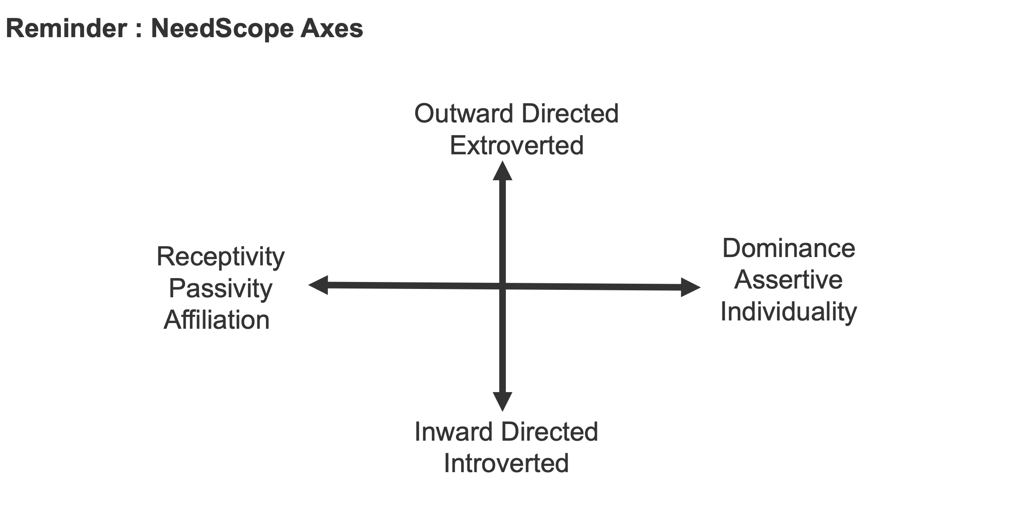

Slide 11
Shape the world around me
Connection & Shared Experiences
Channeling the best in me
Autonomy & Self Direction
Safeguard what matters most

Slide 12
Shape the world around me
Exploration
Mastery
Connection & Shared Experiences
Belonging
Channeling the best in me
Recognition
Autonomy & Self Direction
Comfort
Security
Safeguard what matters most

Slide 13
Exploration- The need to experience freedom, novelty and possibility. People in this state are driven by curiosity and a desire to break away from routine. They seek new ideas, places, experiences and perspectives that broaden their horizons and make life feel richer. They value brands that inspire discovery, encourage experimentation and help them embrace the unknown.
Mastery- need to shape one's own life through capability, confidence and agency. People in this state are motivated by the desire to grow, improve and take charge of outcomes rather than be constrained by circumstances. They derive satisfaction from developing skills, overcoming challenges and unlocking their potential. They seek products, services and experiences that empower them to perform better, make smarter decisions and live life on their own terms.
Belonging- The need to build meaningful relationships and feel connected to others. People in this state value companionship, shared experiences and a sense of community. They seek acceptance, emotional closeness and mutual support, gravitating towards brands that strengthen relationships and foster togetherness.
Recognition- The need to express individuality and be seen for who one is. People in this state seek self-expression, appreciation and social affirmation. They use products and experiences to communicate identity, celebrate achievements and create memorable moments. They are drawn to brands that help them stand out, feel special and reinforce their sense of self.
Comfort- The need for emotional and physical ease, reassurance and wellbeing. People in this state seek calm, warmth and relief from stress or uncertainty. They value familiarity, care and environments that help them feel safe, restored and at peace. Brands that reduce friction, provide reassurance and create moments of comfort naturally resonate here.
Security- The need for stability, certainty and control over one's life. People in this state are motivated by reducing risk, protecting what they value and preparing for the future. They seek predictability, reliability and confidence in their decisions, preferring brands that inspire trust, minimise uncertainty and help them feel in control.

Slide 14
Exercise - 7
Plot Specific Brand Consumers of Mom Care Products in following needscope
Orimi, Moms Co, Medela, Earth Mama & Pro MOM
HINT – watch ads, read websites and see packaging to identify key motivations of a mother they are focusing on
Which psychographic is the potential whitespace and then make a pen portrait for that consumer

Slide 15
Psychographics
Need State | Core Psychographics
Mastery | Ambitious, self-reliant, capable, determined, growth-oriented, achievement-driven, in-control
Recognition | Expressive, confident, individualistic, status-aware, validation-seeking, identity-conscious, proud
Exploration | Curious, adventurous, open-minded, spontaneous, novelty-seeking, experimental, freedom-seeking
Belonging | Sociable, inclusive, relationship-oriented, collaborative, community-minded, affectionate, affiliative
Comfort | Reassurance-seeking, nurturing, sensitive, ease-seeking, familiar, restorative, emotionally grounded
Security | Cautious, responsible, risk-aware, structured, dependable, certainty-seeking, prepared

Slide 16
Who is the Anchor TG for Rolex

Slide 17
Exercise - 8
Lavani is the Anchor TG of Sugar
You have to enumerate the USER TG of Sugar,
If you have to decide the USER TG for the next 3 years for SUGAR ( You are in day of the start up) what would it be?
Go through the Excel sheet and prep a sheet like that of Epigamia ( next slide)

Slide 18

TG of Epigamia
Communication TG – M/F, 28, Metro, NCCSA Bold, Ambitious, Lifestyle & Convenience Seeker
User TG – 5cr. Consumers, 18-60 in the top 50 towns
Notes:
Useful Links –
NCCS Data - https://www.afaqs.com/news/media/42980_a-dummys-guide-to-nccs
In India, Socio-Economic Classification (SEC) is a widely used system to segment households and consumers. It’s not just about income, but also about education of the chief wage earner (CWE) and occupation.
Here’s a snapshot:
1. Old SEC (pre-2011)
Classified households into SEC A1, A2, B1, B2, C, D, E1, E2.
Basis: Education + Occupation of the chief wage earner.
Very urban-centric, not effective for rural segmentation.
2. NCCS (2011 onwards, used by MRUC & MRSI)
Replaced by NCCS (New Consumer Classification System).
Basis:
Education of chief earner
Ownership of consumer durables (like refrigerator, TV, car, two-wheeler, computer, AC, etc.)
Households are classified into NCCS A, B, C, D, E with sub-grades.
It covers both urban & rural India, making it a more robust classification.
3. The ISEC Replaces NCCS
The New Consumer Classification System (NCCS)—based on the education of the chief wage earner and ownership of specified consumer durables—has been officially replaced. On February 21, 2024, the Market Research Society of India (MRSI) announced the launch of the Indian Socio‑Economic Classification (ISEC) system
Why the Shift?
Better Reflects Societal Changes
NCCS became less effective due to increasing penetration of durable assets across all classes, diluting its discriminatory power. ISEC addresses this limitation. Moneycontrol+7afaqs!+7mrweb.com+7
Includes More Relevant Indicators
Occupation of the chief wage earner
Education level of the most educated adult male
Education level of the most educated adult female
Notably, this is the first classification to actively include women's educational attainment—marking a shift toward gender-equitable metrics. Research Live+12pressinsider.com+12afaqs!+12Storyboard18+2Moneycontrol+2
More Granular Tiering
ISEC uses a refined 12-tier system, compared to NCCS’s fewer broad categories, offering finer segmentation for targeting. Research Live+15pressinsider.com+15mrsi.co.in+15
Robust and Stable
It’s designed to be more stable over time and relevant across both urban and rural contexts without needing frequent revisions. Research LiveFree Press Journal+15afaqs!+15The Economic Times+15

Slide 19
Lets have a look at this ad!
Notes:
https://www.linkedin.com/pulse/brand-stories-how-consumer-insight-helped-pampers-beat-sombit-roy

Slide 20

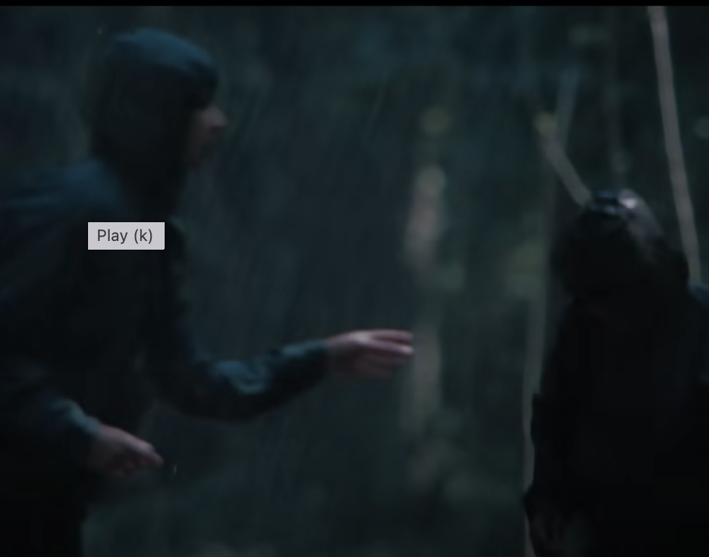
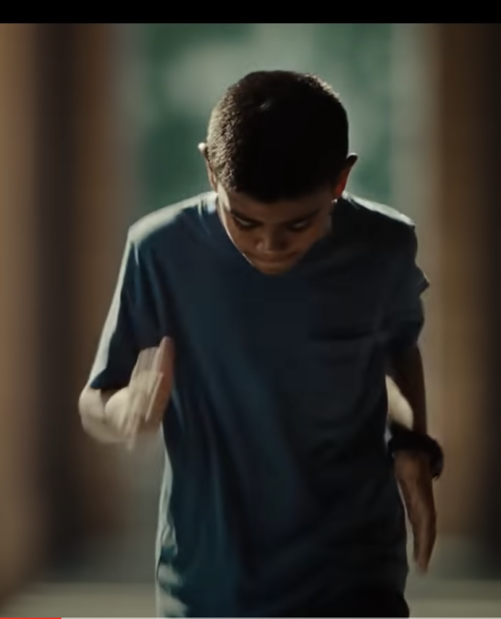
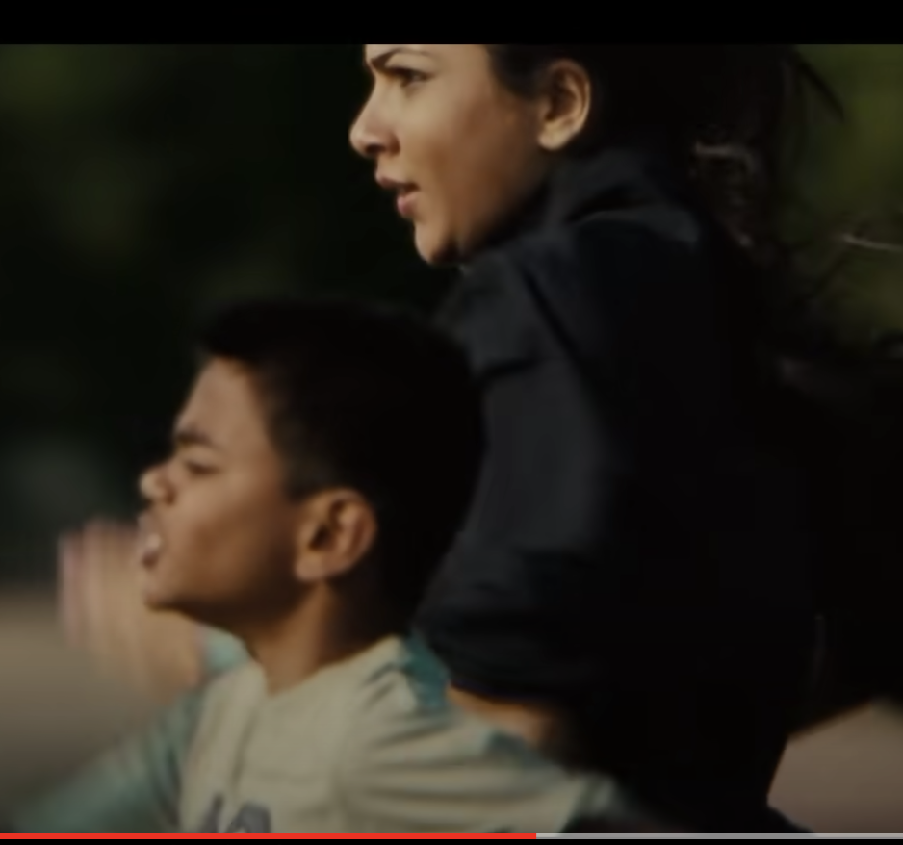
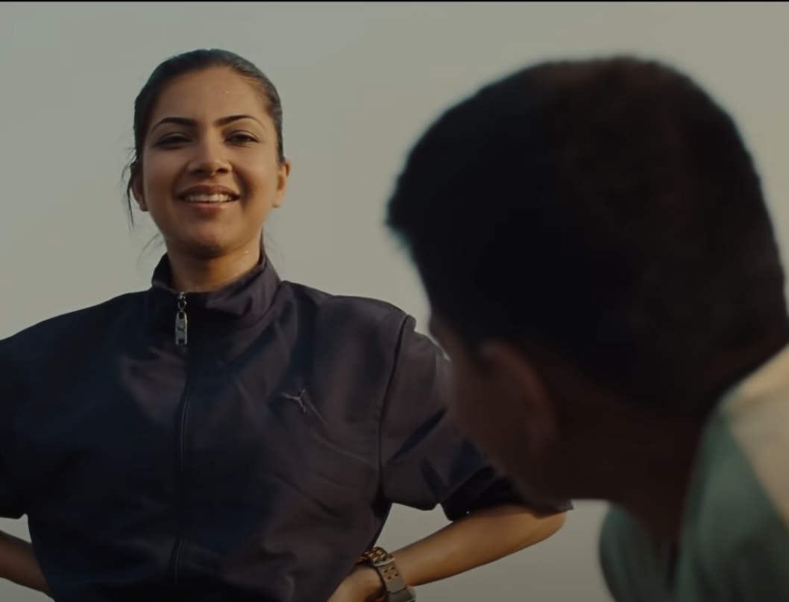
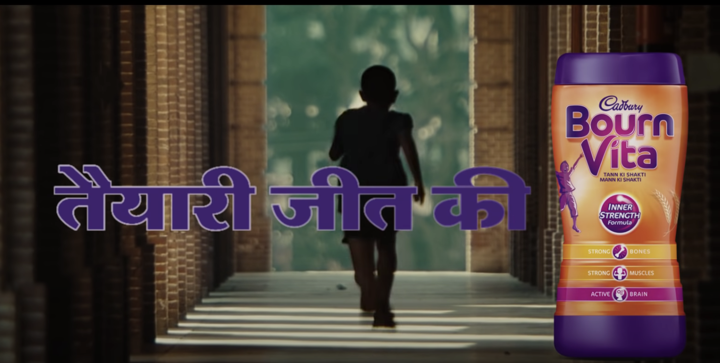
“ My success is in my child doing better than me”
INSIGHT

Slide 21
What is an Insight?
An insight is an in-depth understanding of the motivations, attitudes, beliefs, and / or feelings that cause a behavior or non-behavior in a user or a shopper
IN
SIGHT
Psychological Dimension: What’s in their heads
Behavioral Dimension: What can be observed

Slide 22
“Tayarri Jeet Ki”
An insight is an in-depth understanding of the motivations, attitudes, beliefs, and / or feelings that cause a behavior or non-behavior in a user or a shopper
IN
SIGHT
Psychological Dimension: What’s in their heads
Behavioral Dimension: What can be observed
“ Habits will ensure he/she wins and this will be my win”
“ I inculcate good habits in my child

Slide 23


Thinking and Feeling
Insight Discovery involves “Science” and “Art”
To uncover insights a need for both Thinking and Feeling
THINKING –
Analyzing
Observing
Using data and tools and research
Connecting the dots
Comparing data from different data sources
FEELING –
Open to receiving information
Be curious
Have fun, play, keep a sense of mystery
Be passionate and empathetic listener
Put yourself in their shoes
Dig into the emotional underpinnings, deep seated, unspoken feelings
Use common sense/how would
you feel?
Be perceptive
Continuously Ask Why, What, So What, Now What?
Notes:
So insight discovery has two key components—what we are going to call mechanical tools, which includes the data and research studies we have available and always spend a lot of time looking at, and the human tools which involve thinking, feeling and creating.
The human tool of “thinking” covers the traditional headset of analyzing information, observing, comparing data, and connecting dots. But this must also be supplemented with the ability to feel and create, which is were curiosity and open mindedness come into play
23

Slide 24




Uncovering Insights and how to use the 5 Whys
Question asking method used to explore the cause/effect relationship underlying a particular problem
Can be applied to the I Wish I Knew questions to dig deeper
As you keep asking WHY you are digging for clues to the whole story
Rule of Thumb
Ask 4-5 Levels of “Whys”
Notes:
There is another tool that can be used to get answers to this questions This is called the 5 Why’s, and is an established question asking method traditionally used to get to the root cause of a particular problem.

Slide 25
“Tayarri Jeet Ki”
IN
SIGHT
Psychological Dimension: What’s in their heads
Behavioral Dimension: What can be observed
“ I inculcate good habits in my child
“ Good habits will set him/her up for success
“ I want him/her to do well and be at a higher position that I was
“ He /her must have a life that is free of the troubles/pains that I had
“ If that happens, I will succeed as a mother!

Slide 26
What the insight here?
Thought experiment by Peter Singer
You are walking by a river in your hometown. You see a child has fallen in. Most people are obliged to jump in a save the child, even if the water destroys their clothes worth Rs 5000/-
On the other hand, a friend calls and and says a child in Somalia is going to die and he is collecting Rs 5000/- to help. Most people hesitated!
Practice Ex
Some sources to know more about this thought experiment and the concept of effective altruism by Peter Singer are in the notes section
Notes:
https://daily-philosophy.com/peter-singers-drowning
-child/#:~:text=The%20philosopher%20Peter%20Singer%20invites,because%20of%20saving%20the%20child%3F

Slide 27
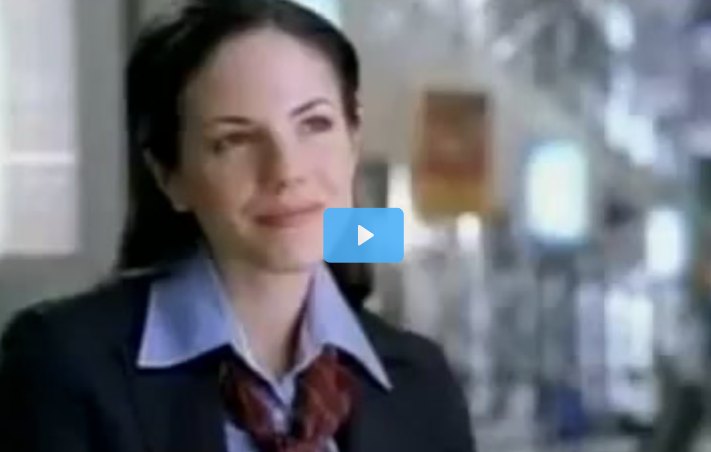
Nicoderm, what the insight here!
Notes:
https://beloved-brands.com/consumer-insight/

Slide 28


Slide 29
Consumer Insight: Lipitor
IN
SIGHT
“All the people I know who have serious health issues—like beginning diabetes, high blood pressure, high cholesterol—they’re way too heavy and out of shape. Me, I’m a good weight, in shape and very active. My arteries will be just fine”
Don’t regularly check cholesterol level
Notes:
Let’s look at an example of how to effectively articulate a user insight in this structure. The product is Lipitor, a cholesterol reducing drug.
Slide build 1: A non-behavior was observed--many people were not getting their cholesterol level checked.
Slide build: The attitude that drove this was …Read the IN.

Slide 30
Consumer Insight: Lipitor
Current:
IN
SIGHT
“All the people I know who have serious health issues—like beginning diabetes, high blood pressure, high cholesterol—they’re way too heavy and out of shape. Me, I’m a good weight, in shape and very active. My arteries will be just fine”
Don’t regularly check cholesterol level
Desired Change:
I didn’t realize that even though I’m active I’m at risk for high cholesterol
I’m going to the doctor to get my cholesterol level checked
Notes:
A good test to check if the insight is truly leverageable is to articulate the desired change. This could be a change in both the IN and the SIGHT, or just a change in one or the other. Importantly, unless there is some change, there is no opportunity, and the insight is probably not relevant.
The desired change here is in both dimensions — the goal is to change their attitude to “I didn’t realize that even though I’m active I’m at risk”, and the new behavior is to go to the doctor to have cholesterol checked. And since Lipitor is the #1 recommended drug in the US, when they do go to the doctor, Lipitor gets the business

Slide 31
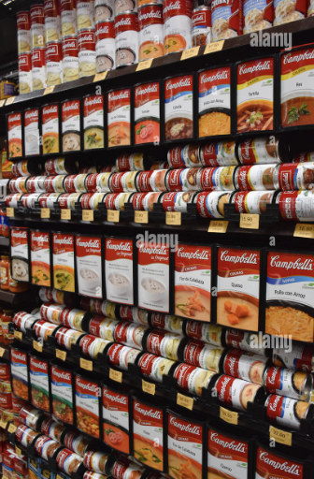
Sight – People were exiting the category and not buying ( or buying enough)
In – overwhelmed with Choice ad unable to decide ( Friction)

Slide 32
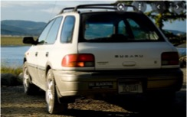
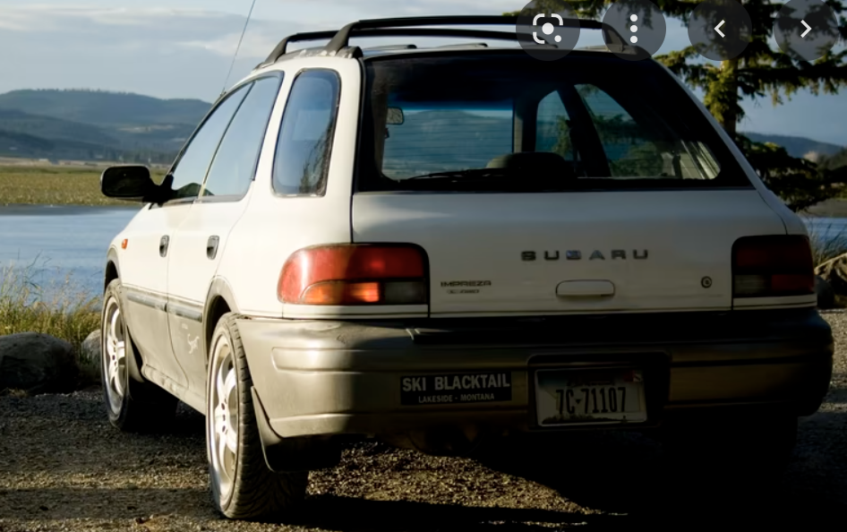
Example – Segmenting & Targetting
Subaru- A Japanese car maker, trying to get a foothold in the US market
“How do you sell a car that was labelled ”Sturdy, if drab”
Tried to change the perception, by launching a luxury car – Failed!
Went back to core – Sell to outdoorsy Types ( need segmentation)
Research threw out a new cohort or users – Lesbians! ( Segmentation + Targeting)

Slide 33
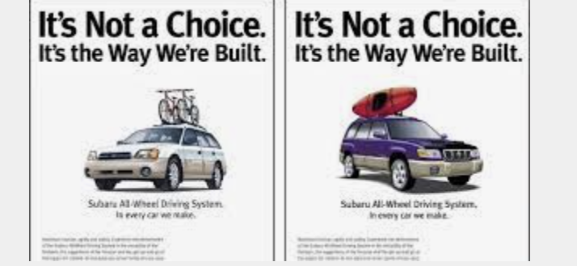
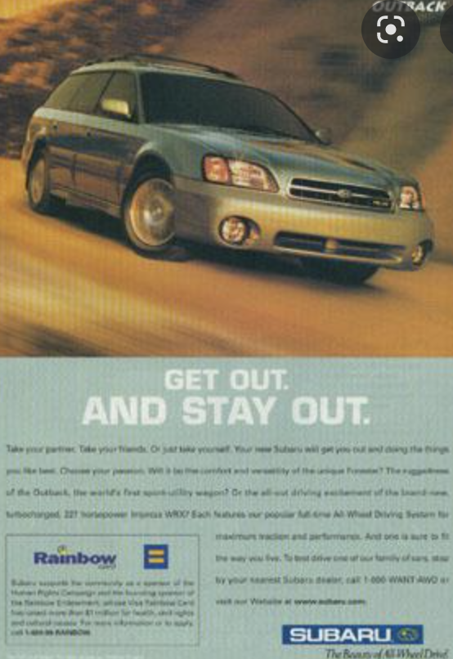
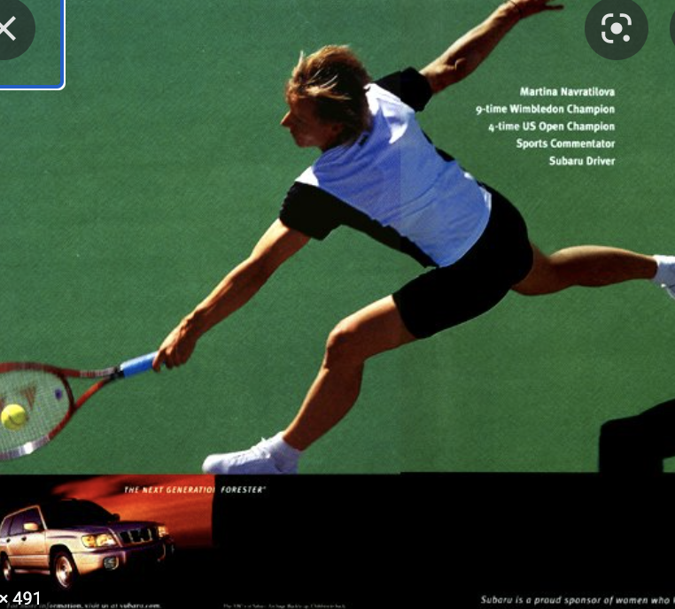

Example – Consumer Insight
Sight – I want a car that could handle dirt roads and haul gear
In – I want to lead an active and low-key lifestyle

